Slide 1
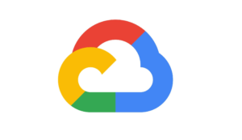
Vertex AI - GCP

Slide 2

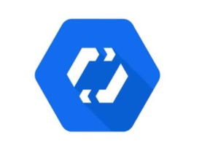
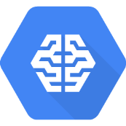

What’s Vertex AI
Vertex AI brings AutoML and AI Platform together into a unified API, client library, and user interface
AutoML allows you to train models on image, tabular, text, and video datasets without writing code, while training in AI Platform lets you run custom training code.
+
=
AutoML
AI Platform
Vertex AI

Slide 3




Types of Data Vertex AI can handle
Vertex AI can train models with 4 types of data
Tabular
Text
Images
Videos

Slide 4
Vertex AI Machine Learning Workflow
DATA PREPARATION
INGEST
ANALYZE
TRANSFORM
MODEL TRAINING
CREATE MODEL
TRAIN MODEL
MODEL DEPLOYMENT
EVALUATE
DEPLOYMENT
PREDICT
*Does not require machine learning expertise to train a model in AutoML

Slide 5
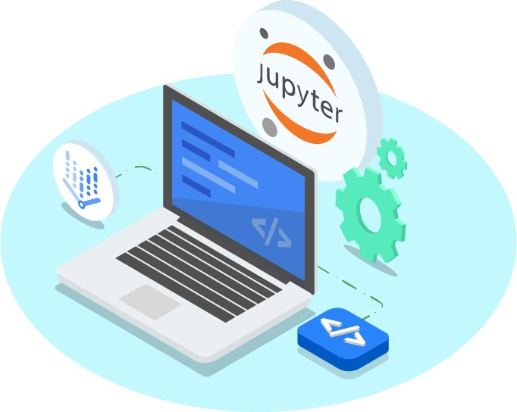
Jupyter Notebooks
Vertex AI allows users to create and use Jupyter Notebooks with a notebook instance. Notebook instances have JupyterLab pre-installed and are configured with GPU-enabled machine learning frameworks

Slide 6
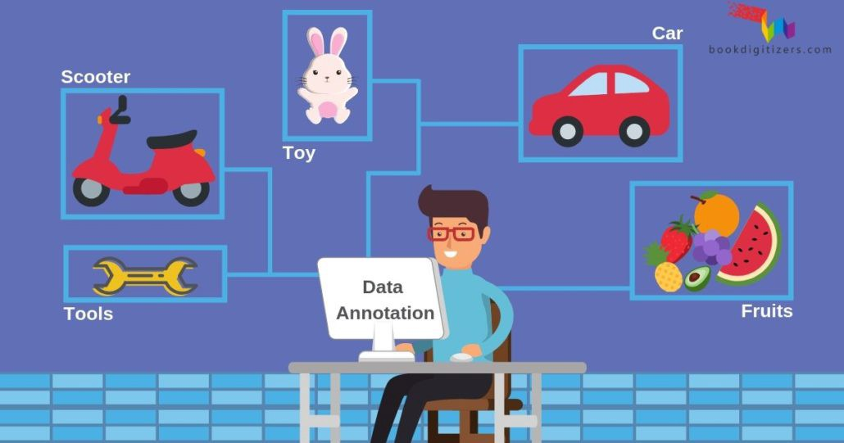
Labeling Tasks
Labeling tasks enables users to label data to train the ML model with accurate information. There are three ways to assign labels to your training data items:
Add the data items to your dataset with their labels already assigned, for example using a commercially available dataset
Assign labels to the data items using the console
Request to have human labelers add labels to the data items

Slide 7
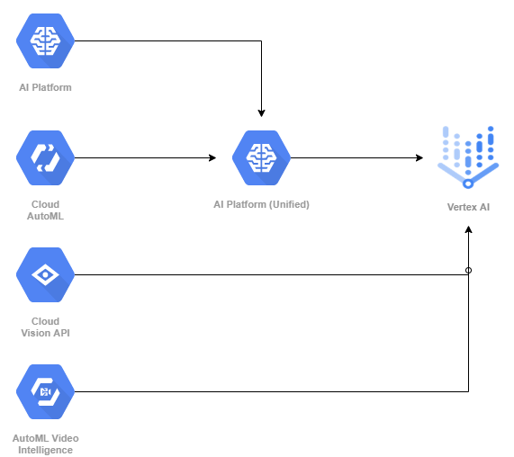

Slide 8
Vertex AI usage in DaaS
For Working around AutoML we can either go with drag and drop method as in vertex or we can move with Query Language in BigQuery.
In Vertex AI which GUI based, but BigQuery is more reliable to use and the components and functionality are same as in vertex AI.

Slide 9

Building AutoML in BigQuery
Model Creation:
CREATE MODEL `Healthy_NTF` OPTIONS
( MODEL_TYPE=‘AUTOML_CLASSIFIER’,
BUDGET_HOURS=3,
INPUT_LABEL_COLS=[‘label’])
Prediction:
SELECT * FROM ML.PREDICT
(MODEL `Healthy_NTF`, SELECT * FROM `Healthy_NTF_Streaming Data`)

Slide 10
Building AutoML in Vertex
Stages in AI Platform Service
Define and upload a dataset
Train the Model
Upload the model in repository
Predictions
Batch Predictions: pull the data from Bigquery/GCS for prediction.
Endpoint: Deploy the model in containerized app for online web application.

Slide 11
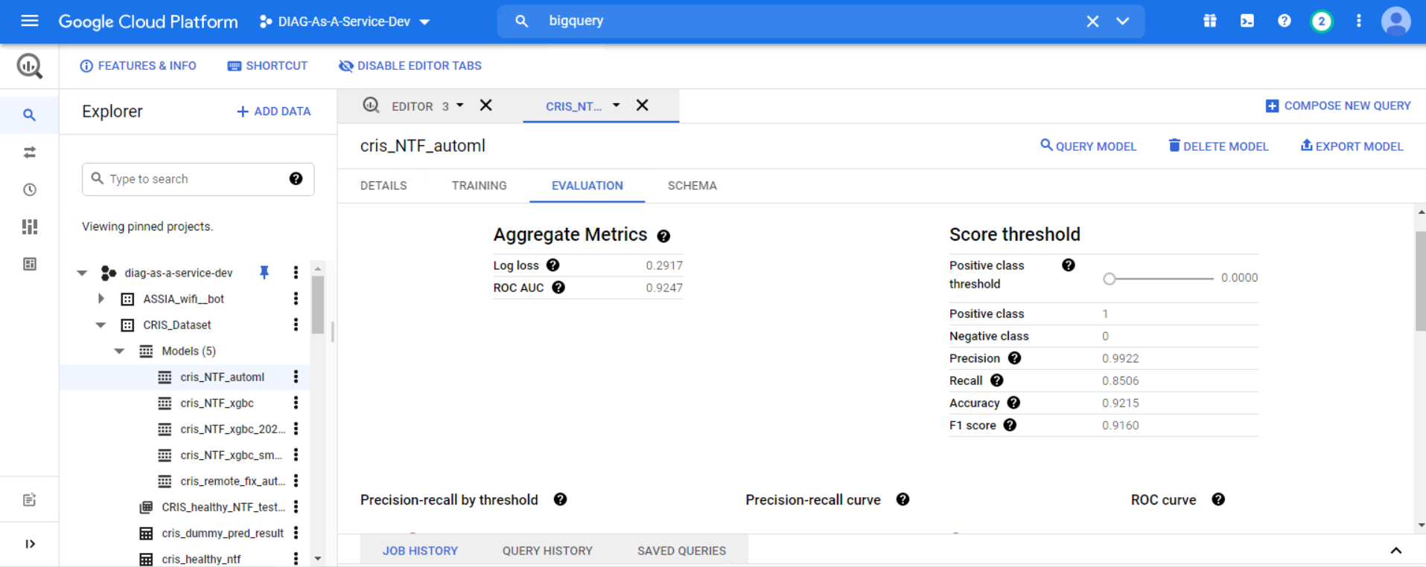
BigQuery ML

Slide 12
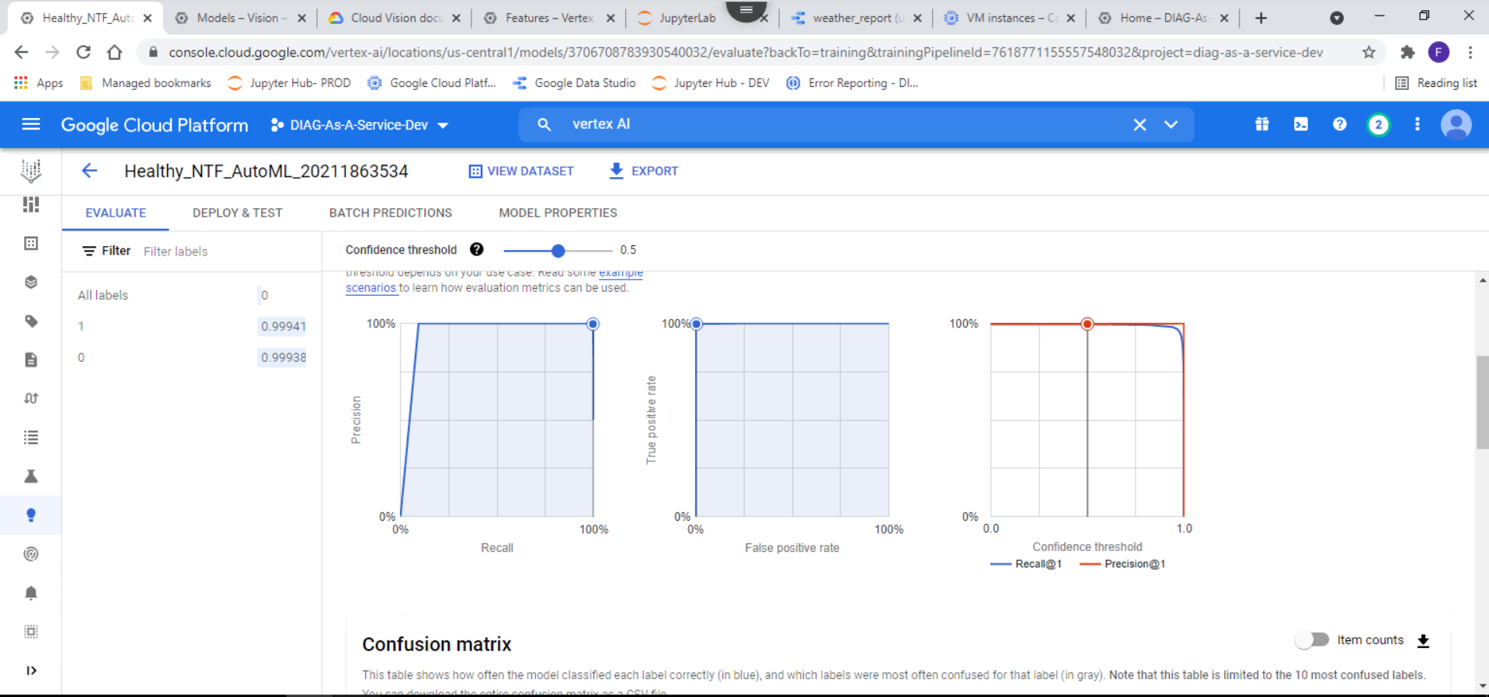
Same training process in vertex

Slide 13
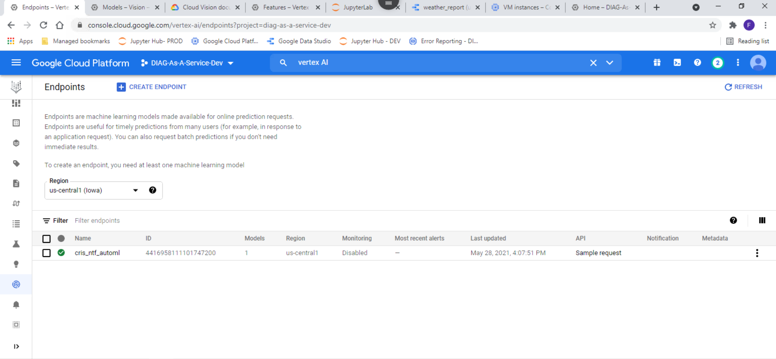
Endpoint API creation
We can create an endpoint for our model file to get the immediate results.

Slide 14
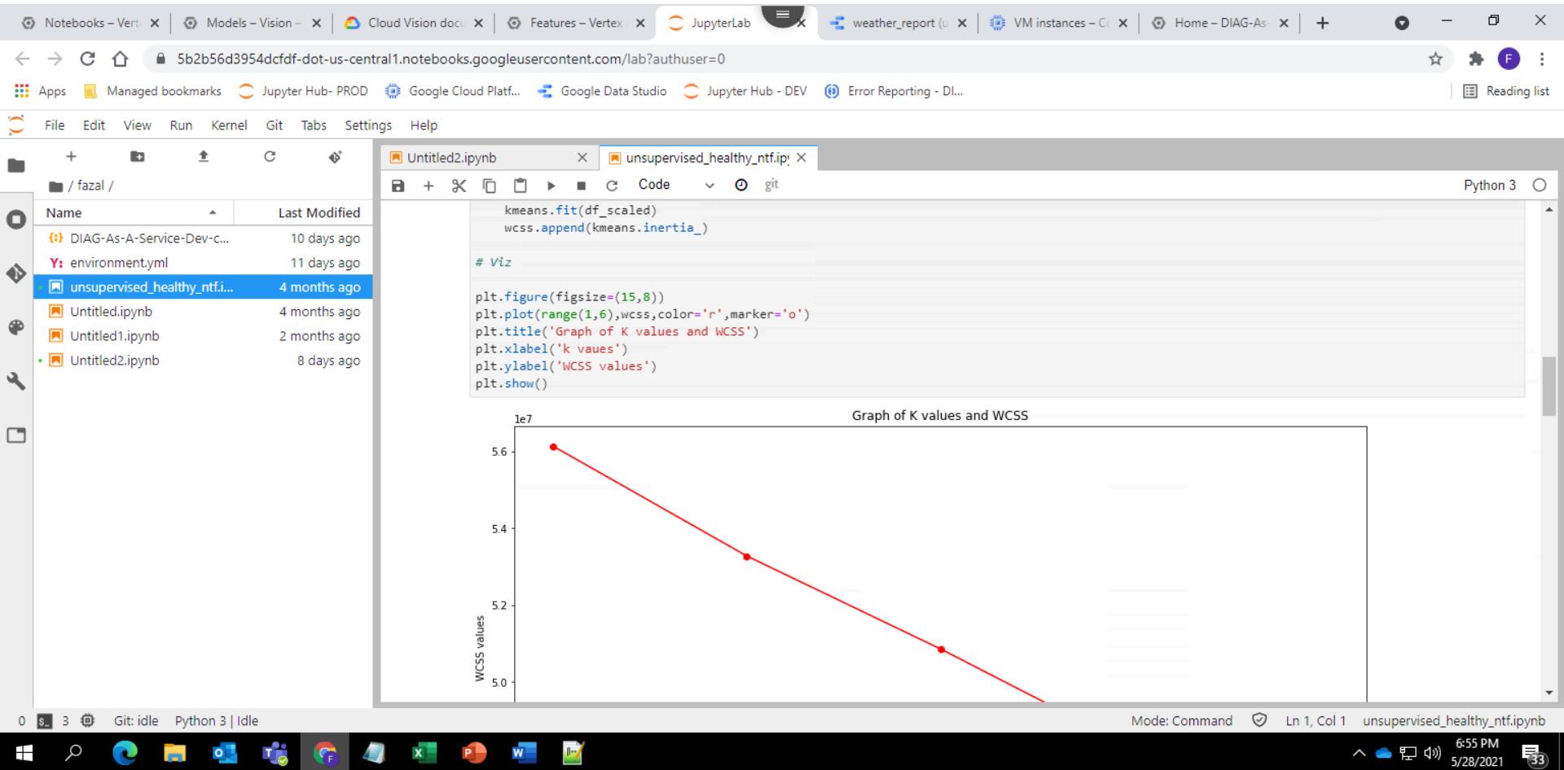
Classic Jupyter lab

Slide 15
In Progress *
Exploration of vertex model for image and video data to achieve the same possibilities as Vyn app.

